Slide 1
Primaquine
Miss.Kavyashri
Guest Lecturer,
Dept.of Pharmaceutical Chemistry ,
Post Graduate Centre Kadur

Slide 2
Introduction
Primaquine is a 8 aminoquinoline derivative and is available as a phosphate salt. this is important drug which is used in second stage of infectious disease means merozites in the blood are considered as a stage 2.this helps to block the stage 2,hence it is act as a antimalarial drug for the treatment of malaria.

Slide 3
Properties and uses of primaquine
It is an odorless orange red crystalline powder which is bitter in taste .
It is slightly soluble in water ,practically insoluble in alcohol ,ether and chloroform.
It should be stored in well closed container protected from light.
It is used ti prevent relapse of malaria.

Slide 4
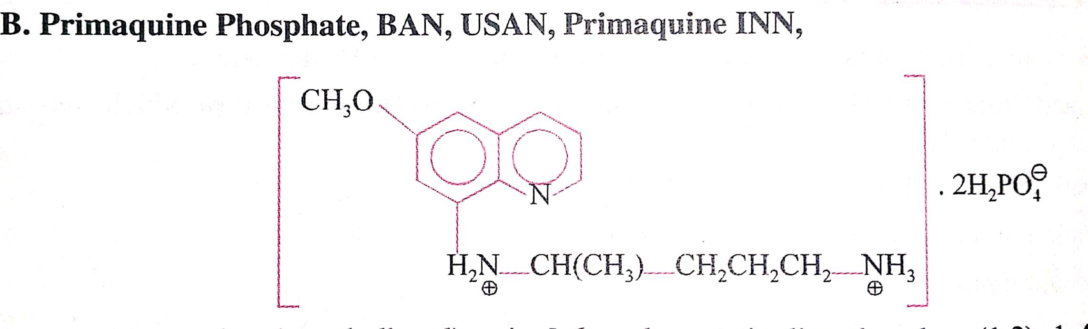
structure of Primaquine phosphate

Slide 5
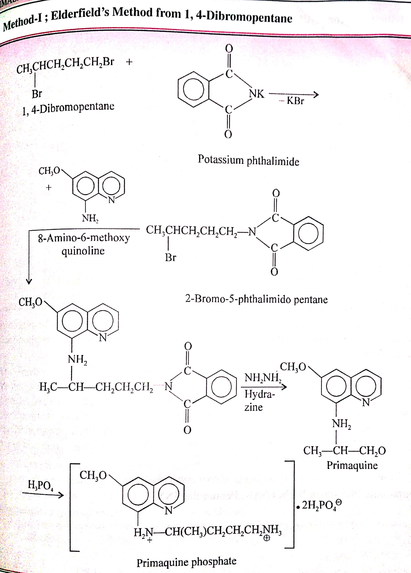
Synthesis of primaquinne

Slide 6
Mode of action of primaquine
This drug is used to block the stage 2 and 4 ,it means that block the formation of gametocytes.
Primaquine phosphate drug enters into the cell of the plasmodium species and binds to the DNA of the parasites and stop the nucleic acid synthesis .finally it degrade the plasmodium species.

